Slide 1
Lesson 5 - Series & Central Tendency
Mack 2021

Slide 2
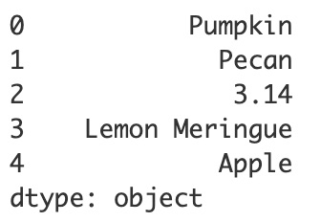
Pandas Series
A series is one-dimensional, labeled array (or list) that is formatted like a single column of a data table.
import pandas as pd
pies = pd.Series(["Pumpkin", "Pecan", 3.14, "Lemon Meringue", "Apple"])
print(pies)
Notes:
Python and the pandas library can be used to create a series. A series is similar to a list, but it is formatted like a single column of a data table. When a series is created, each entry, or item, will be assigned a labeled index starting with 0. Also notice that the data type of the items in the series is printed out as well. The list used here contains Strings which are objects.

Slide 3
Pandas Series
A series is one-dimensional, labeled array (or list) that is formatted like a single column of a data table.
import pandas as pd
pies = pd.Series(["Pumpkin", "Pecan", 3.14, "Lemon Meringue", "Apple"])
print(pies)
Notes:
Let’s go over the syntax. First, we import the pandas library. Pandas is often abbreviated as pd, this way later in the program, we can just type pd instead of typing out the full word ‘pandas’.

Slide 4
Pandas Series
A series is one-dimensional, labeled array (or list) that is formatted like a single column of a data table.
import pandas as pd
pies = pd.Series(["Pumpkin", "Pecan", 3.14, "Lemon Meringue", "Apple"])
print(pies)
Notes:
pies is the variable name that we are going to use to store our Series. We use pd (which calls on the pandas library) followed by a period and the word Series. The S should be capitalized in Series.

Slide 5
Pandas Series
A series is one-dimensional, labeled array (or list) that is formatted like a single column of a data table.
import pandas as pd
pies = pd.Series(["Pumpkin", "Pecan", 3.14, "Lemon Meringue", "Apple"])
print(pies)
Notes:
Here, you can see the list! This list will be used to populate the series.

Slide 6
Pandas Series
A series is one-dimensional, labeled array (or list) that is formatted like a single column of a data table.
import pandas as pd
pies = pd.Series(["Pumpkin", "Pecan", 3.14, "Lemon Meringue", "Apple"])
print(pies)
Notes:
Finally, we print the series by using the print statement and the variable that has stored the Series.

Slide 7
Specifying Indices
pies = pd.Series(["Pumpkin", "Pecan", "Pizza", "Lemon Meringue", "Apple"])
print(pies)
Notes:
There’s a lot more that we can do when creating a series as well. By default, the items in the series are each given an index starting at 0. But we can change this index.

Slide 8
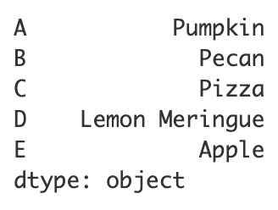
Specifying Indices
pies = pd.Series(["Pumpkin", "Pecan", "Pizza", "Lemon Meringue", "Apple"],
index=["A", "B", "C", "D", "E"])
print(pies)
Notes:
By including a comma and then index= we can use another list that will act as the index instead of using the default numbering.

Slide 9
Measures of Central Tendency
Weights (in pounds) of cats at the shelter: 7, 18, 12, 9, 11, 8, 10, 11, 12, 13
Mean:
Median:
Mode:
Notes:
Let’s explore a dataset of the weights of cats at a local shelter. Now that we can format our data in a series, we can use functions that are built into the pandas library to find the mean, the median and the mode. Remember that we could do this in the past, using lists, but had to import and use the statistics library. We don’t need to do this now, because these functions are included within the pandas library. Let’s talk about these three different measures of central tendency. Central tendency is a summary of different measures that attempts to find the center of a data set. You may be familiar with some of these measures.

Slide 10
Measures of Central Tendency
Weights (in pounds) of cats at the shelter: 7, 18, 12, 9, 11, 8, 10, 11, 12, 13
Mean: add all of the numbers and divide by the number of items in the set
Median:
Mode:
Notes:
The mean is calculated by adding up all of the values and dividing by the number of items in the set.

Slide 11
Measures of Central Tendency
Weights (in pounds) of cats at the shelter: 7, 18, 12, 9, 11, 8, 10, 11, 12, 13
Mean: add all of the numbers and divide by the number of items in the set
Median: the middle number, when the set is arranged in order
Mode:
Notes:
The median is the middle number, when the set is arranged in chronological order.

Slide 12
Measures of Central Tendency
Weights (in pounds) of cats at the shelter: 7, 18, 12, 9, 11, 8, 10, 11, 12, 13
Mean: add all of the numbers and divide by the number of items in the set
Median: the middle number, when the set is arranged in order
Mode: the number that appears the most often
Notes:
And the mode is simply the number, or data value, that appears the most in the dataset.

Slide 13
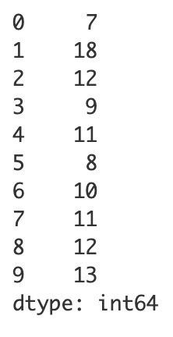
Measures of Central Tendency
cats = pd.Series([7, 18, 12, 9, 11, 8, 10, 11, 12, 13])
print(cats)
Notes:
Here is the cat weight data formatted into a series. Notice, that the data type for this series is listed as int64. This means that the data contains integers. The 64 represents the size of the datatype storage which is 64 bytes. This determines how large of an integer you can store.
It’s a little confusing to have cats numbered like this, so let’s give these cats names to use as the indices, instead.

Slide 14
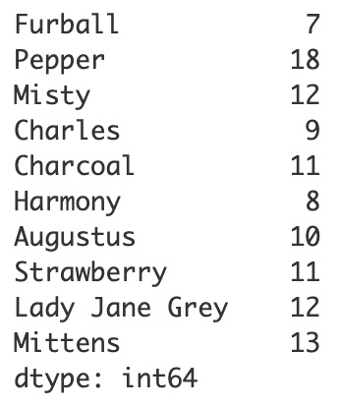
Measures of Central Tendency
cats = pd.Series([7, 18, 12, 9, 11, 8, 10, 11, 12, 13],
index=["Furball", "Pepper", "Misty",
"Charles", "Charcoal", "Harmony",
"Augustus", "Strawberry",
"Lady Jane Grey", 'Mittens" ])
print(cats)
Notes:
Much better. We can use the mean, median and mode functions to determine the central tendency of this data.

Slide 15
Measures of Central Tendency
cats = pd.Series([7, 18, 12, 9, 11, 8, 10, 11, 12, 13],
index=["Furball", "Pepper", "Misty",
"Charles", "Charcoal", "Harmony",
"Augustus", "Strawberry",
"Lady Jane Grey", 'Mittens" ])
print(cats)
print(cats.mean())
11.1
Notes:
To do this, we use a print statement, call on the cats dataset and use the mean() function. The mean prints out as 11.1.

Slide 16
Measures of Central Tendency
cats = pd.Series([7, 18, 12, 9, 11, 8, 10, 11, 12, 13],
index=["Furball", "Pepper", "Misty",
"Charles", "Charcoal", "Harmony",
"Augustus", "Strawberry",
"Lady Jane Grey", 'Mittens" ])
print(cats)
print(cats.mean())
print(cats.median())
11.1
11.0
Notes:
Let’s do the same for the median. The median is 11.0. Let’s find the mode next.

Slide 17
Measures of Central Tendency
cats = pd.Series([7, 18, 12, 9, 11, 8, 10, 11, 12, 13],
index=["Furball", "Pepper", "Misty",
"Charles", "Charcoal", "Harmony",
"Augustus", "Strawberry",
"Lady Jane Grey", 'Mittens" ])
print(cats)
print(cats.mean())
print(cats.median())
print(cats.mode())
11.1
11.0
0 11
1 12
dtype: int64
Notes:
This is different. Since there can be more than one mode, as in this dataset, the mode function prints out another series, that lists the mode or modes. Here, we see that the values of 11 and 12 appear the most often in the data.
Now that we know how to find these three measures, let’s talk about how to determine which measure is the best measure of central tendency. We may have learned in the past that the average, or mean was always the best measure of central tendency, but this isn’t necessarily true.

Slide 18
Measures of Central Tendency
7 8 9 10 11 11 12 12 13
Mean: use when points are not too spread out and there are no outliers
Notes:
In summary, the mean is typically the best measure of central tendency when the points are not too spread out.

Slide 19
Measures of Central Tendency
1 1 1 7 8 9 10 11 11 12 12 13 18 26
Mean: use when points are not too spread out and there are no outliers
Median: use when there are extreme outliers or the data is not balanced well
Notes:
The median is best when we want to avoid outliers from negatively affecting our data.

Slide 20
Measures of Central Tendency
7 7 7 7 7 8 8 8 9 9
Mean: use when points are not too spread out and there are no outliers
Median: use when there are extreme outliers or the data is not balanced well
Mode: use when there are only a few different data values
Notes:
And the mode is best when there are only a few different values.

Slide 21
Lesson Vocabulary
Term | Definition
series | A one-dimensional, labeled array (or list) that is formatted like a single column of a data table.

Slide 22
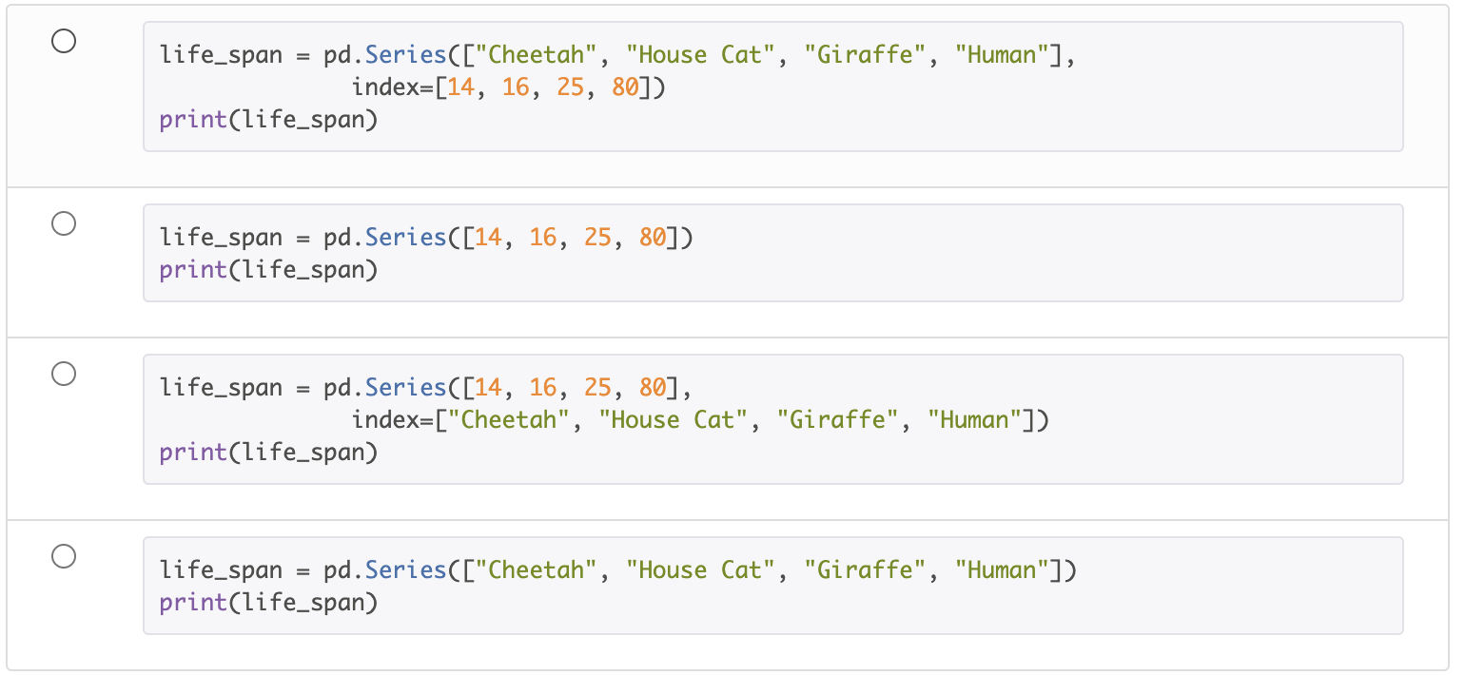
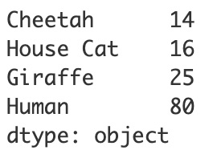
Which code snippet could be used to print the following series?
Notes:
🍐 This is a Pear Deck Multiple Choice Slide. Your current options are: A: A, B: B, C: C, D: D,
🍐 To edit the type of question or choices, go back to the "Ask Students a Question" in the Pear Deck sidebar.

Slide 23
Which measure is best to use to avoid outliers from corrupting the average?
Notes:
🍐 This is a Pear Deck Multiple Choice Slide. Your current options are: A: mean, B: median, C: mode, D: None of these,
🍐 To edit the type of question or choices, go back to the "Ask Students a Question" in the Pear Deck sidebar.

Slide 24
Which data value is most likely an outlier in the dataset below?
89, 100, 95, 26, 79, 85, 98, 75
Notes:
🍐 This is a Pear Deck Multiple Choice Slide. Your current options are: A: 26, B: 75, C: 98, D: 100,
🍐 To edit the type of question or choices, go back to the "Ask Students a Question" in the Pear Deck sidebar.

